Slide 1
Code of Conduct
Enforcement Training
CC NC-BY-SA
Otter Tech LLC
sharp@otter.technology

Slide 2
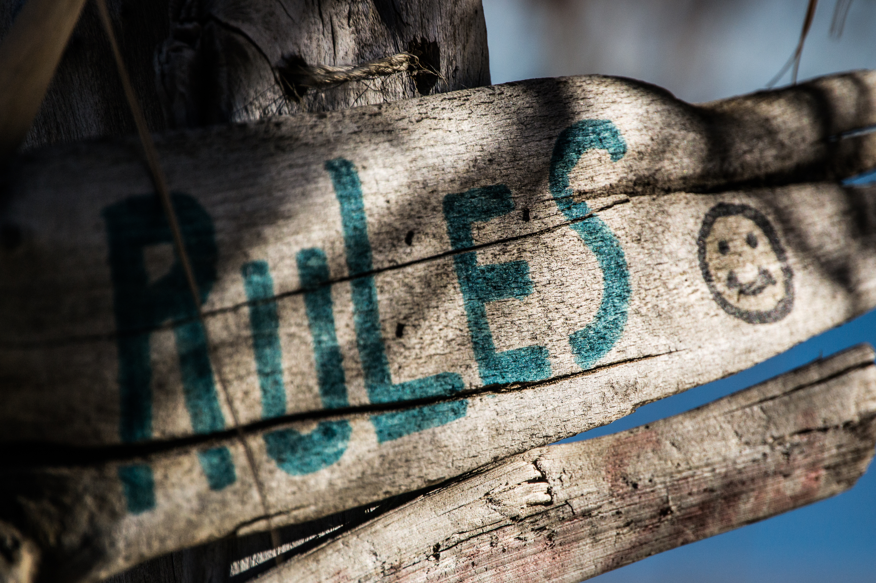
Ground Rules
This is a safe(r) space
If you are asked to stop, you will stop
You may leave at any time
Be open to new knowledge
Acknowledge different lived experiences
CC BY Steve Johnson

Slide 3
Agenda
Code of conduct enforcement duties
Practice: Taking a report
Evaluating a report
Practice: Following up on a report

Slide 4
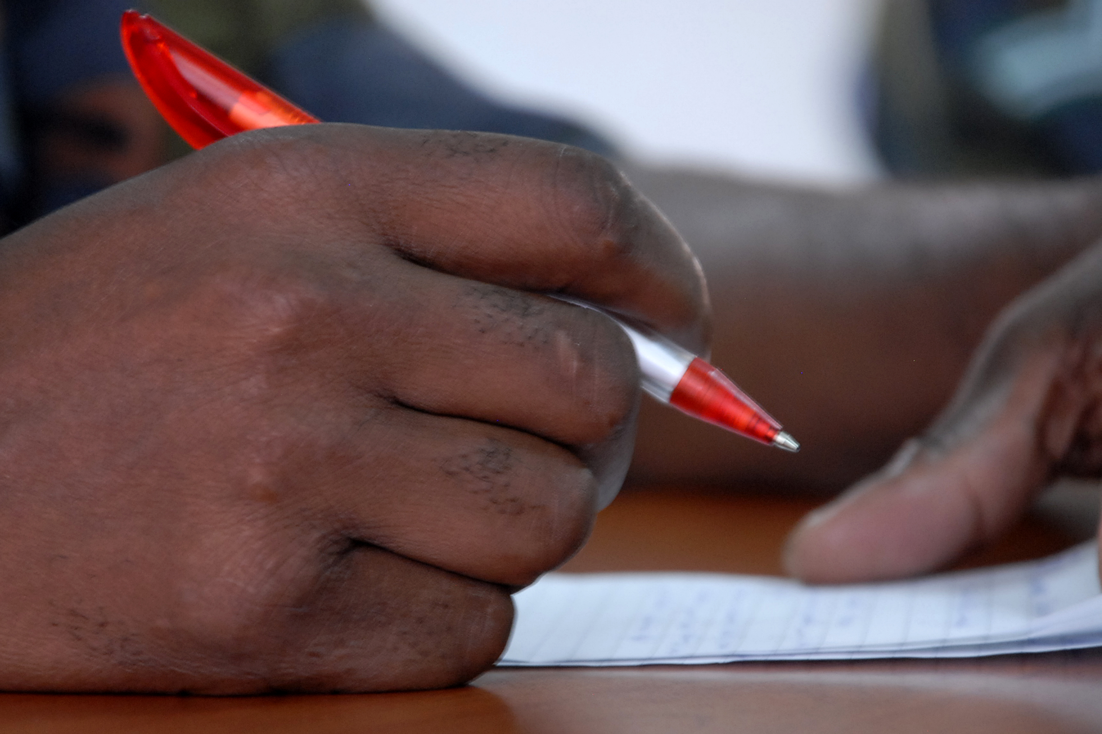
Vocabulary
Code of Conduct incident
Reporter
Reported person
Third party witness
Incident Responder
CC BY U.S. Army Africa

Slide 5
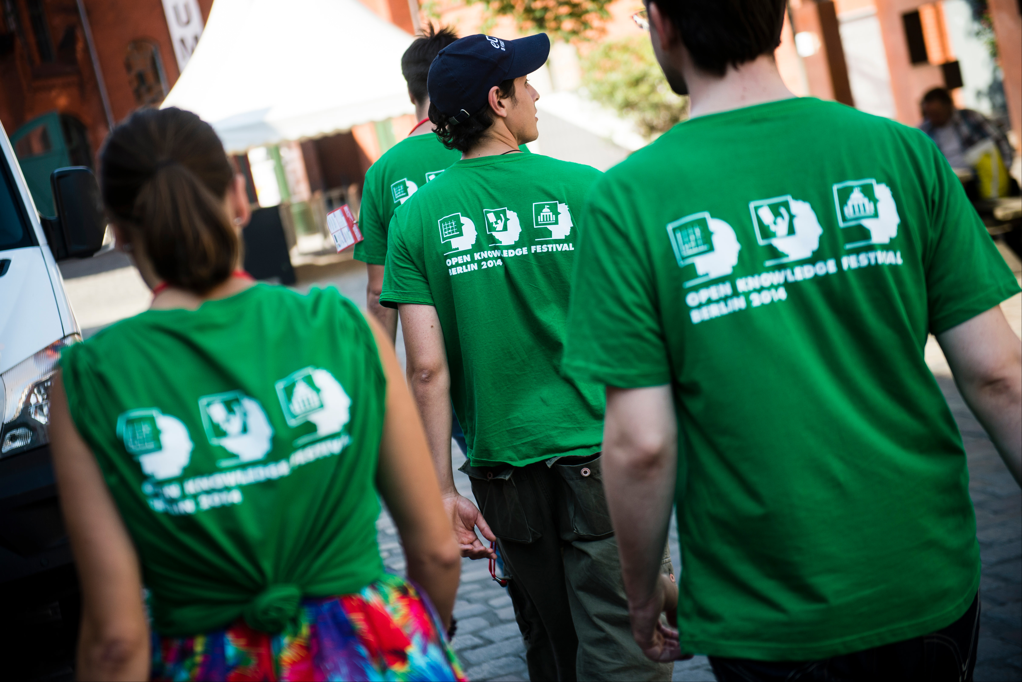
Incident Responder Duties
Takes incident reports
Protects reporter privacy
Assesses the situation
Discuss with committee
Resolves the incident
Responds to those impacted
Documents the incident
CC BY Open Knowledge

Slide 6

Common Reporter Emotions
Repeating themselves
Becoming flustered
Talking fast
Mistrust
Judgment words
Anger
Emotion CC BY 2.0 Osamu Kaneko

Slide 7
Acknowledging Reporter Emotions
"You felt (emotion) when (behavior)."
Example: "You felt scared when they raised their voice."
Softening the directness:
"So you felt..."
"It sounds like you felt..."
"I'm hearing that you felt..."
"Nonviolent communication" by Marshall B. Rosenberg, PhD

Slide 8
Taking an Incident Report: LASER
Before: Ask if they want to go to a quiet, private place (or encourage them to use private message/video chat)
Listen and summarize
Acknowledge emotions with "You" statements
Seek assistance or resources as needed
Ensure everyone is safe
Report or Respond to the incident
After: Get contact info. Evaluate reporter privacy. Thank the reporter.

Slide 9
Practice
Receiving Reports

Slide 10
Discussion
For the incident responder:
What was hard or complicated?
For the reported person:
What did the incident responder do well?
What techniques did the incident responder use?
Any effective phrases?

Slide 11



Intent vs. Impact
Intent
behavior

Slide 12

Intent is Not Magic
Action or inaction has impact
Good intent still causes harm
Harm causes strong emotions
Goal: Stop the behavior
Ensure reported people understand their impact
Allow reporters to express their emotions
CC BY Fabricio Zuardi
(modified)

Slide 13
Evaluating Risk
 | Low Risk | High Risk
Low Impact | Inappropriate behavior in private message | Repeated borderline incidents Pattern of verbal or emotional abuse
High Impact | Inappropriate behavior on a public channel | Sexual harassment Stalking Publishing private information (doxxing)

Slide 14
Deciding Response
 | Low Risk | High Risk
Low Impact | Issue warning | Monitor and document patterns of behavior, warn or temporary ban, remove from leadership
High Impact | Reprimand, removal of offensive material Public response from moderators | Coordinated planning Additional resources Reach out to others

Slide 15
Before Speaking to a Reported Person
Write down:
Their behavior and impact
A behavioral modification plan
Consequences for their behavior (?)
What will happen if they don't agree to modify their behavior?
Who can they appeal the decision to?
What changes will address systemic issues?

Slide 16
Common Reactions for Reported People
Defensiveness
Denial
Blame shifting
Seeking reassurance
Self blame
Manipulation
Emotion CC BY 2.0 Osamu Kaneko

Slide 17
Following up with the reported person: BIRDS
Speak privately via direct message or video chat
State what their Behavior was without judgment words
State the Impact on the reporter or community
Allow the reported person to Respond
Don't reassure or allow the reporter to be contacted
Set a behavioral modification plan
Call them in. Accept apologies on behalf of the reporter.
Notes:
“Hi, can I speak with you privately?”
“That's not appropriate.”
“They asked you to stop.”
“This is a private venue.”

Slide 18
Practice:
Following up with
the Reported Person

Slide 19
Discussion
For the incident responder:
What was hard or complicated?
For the reported person:
What did the incident responder do well?
What techniques did the incident responder use?
Any effective phrases?

Slide 20
Following up after an incident
Try to privately talk to everyone impacted
Document the incident
Addressing systemic change: Adopt a "hey guys" chat bot to list alternatives
May need a statement to the community, e.g.
"Folks, this is a reminder from the moderation team. Please avoid using the term 'guys' to refer to the whole community. The word 'guys' may make women and non-binary community members feel excluded. We need everyone's help to make our community more inclusive."

Slide 21
Thank you!
Twitter: @_sagesharp_ or @ottertechllc
Resources:
https://otter.technology/code-of-conduct-training
https://github.com/sagesharp/code-of-conduct-training

Slide 22
Back up

Slide 23

Microaggressions: Constant Inequality
Harm caused because your identity is not considered "the default"
e.g. disability, race, gender
May happen daily
Invisible to the "default" identity
Death by 1,000 paper cuts
Under reported CoC violation
CC BY Andrew McGill

Slide 24
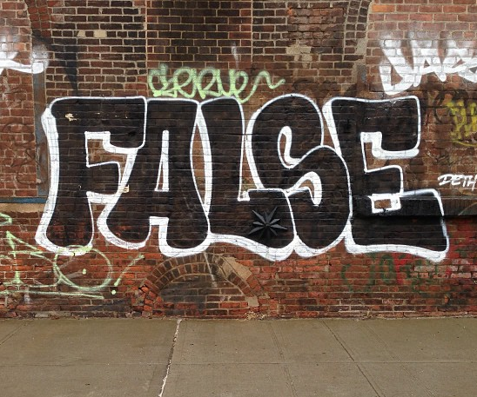
False Reporting: Power Dynamics
What does a reporter have to lose?
Safety
Mental health
Career
Financial support
What does the reported person have to lose?
How likely is it the reporter will lose?
CC BY Adam Lehman

Slide 25
Review All Reports Carefully
Microaggressions & sexual harassment are under reported
Examine the power dynamics
Be cautious of when power dynamic is reversed:
"racism against white people"
"sexist discrimination of men"
other "reverse-isms"
CC BY Adam Lehman

